Slide 1
Housing and the Law
Photoset
Historic and Contemporary Images

Slide 2
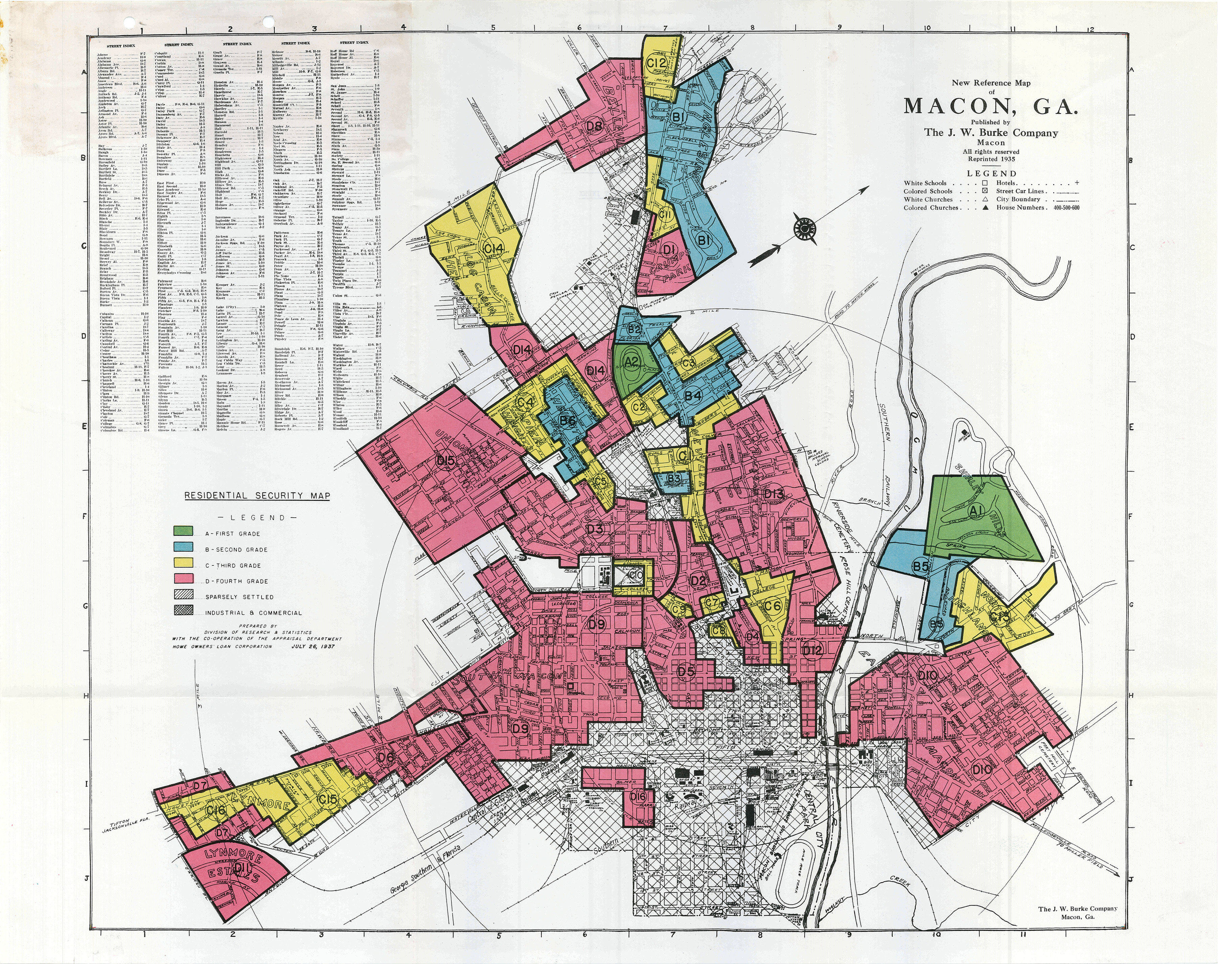

Slide 3
Notes:
God Save the South booklet, with a rare music cover illustration, published in Richmond, Virginia.

Slide 4
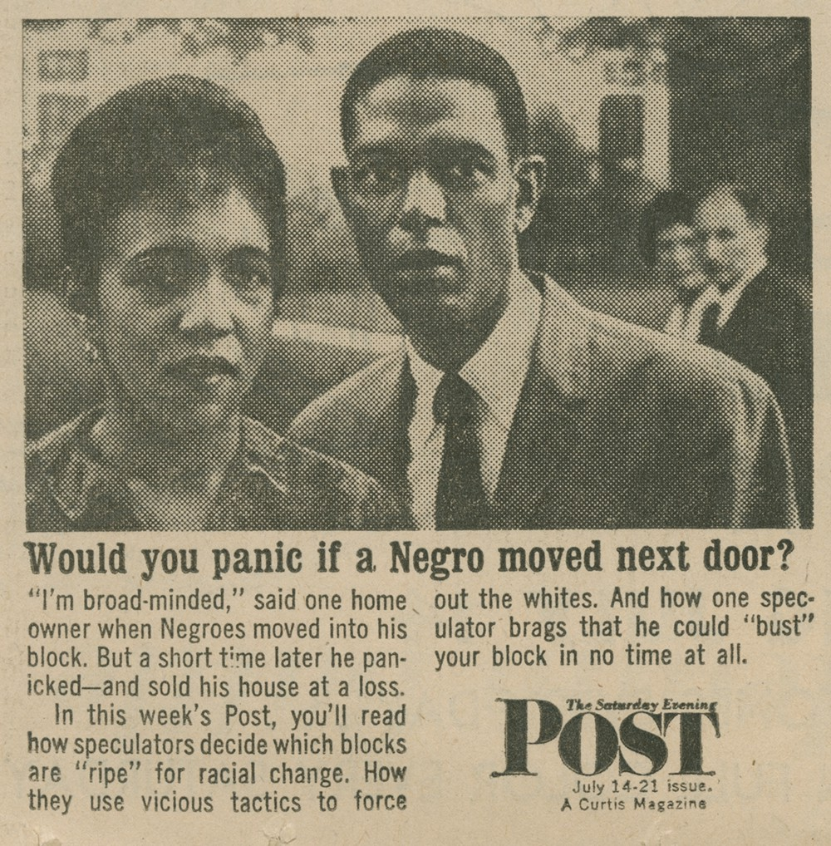

Slide 5
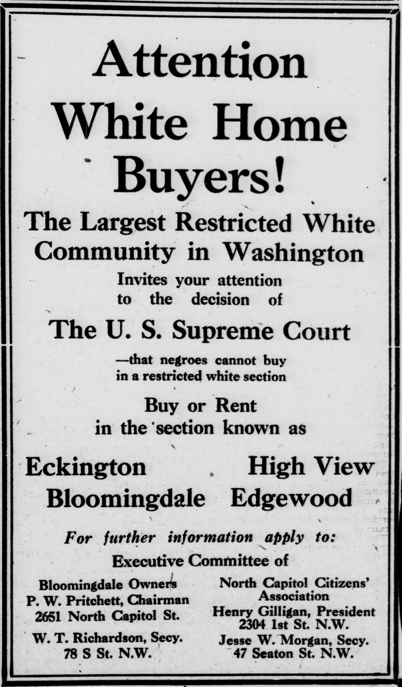

Slide 6
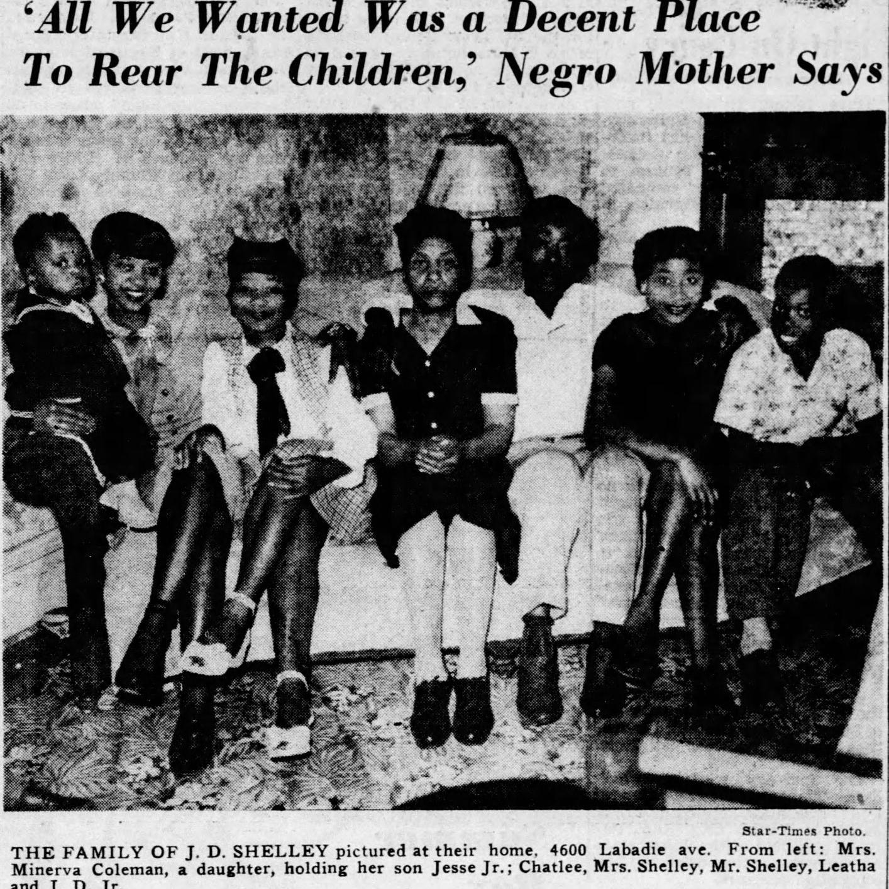

Slide 7
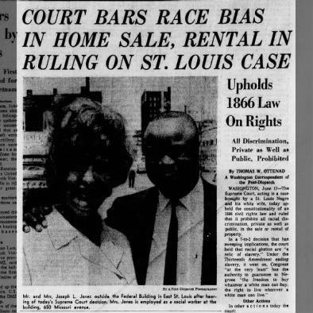

Slide 8
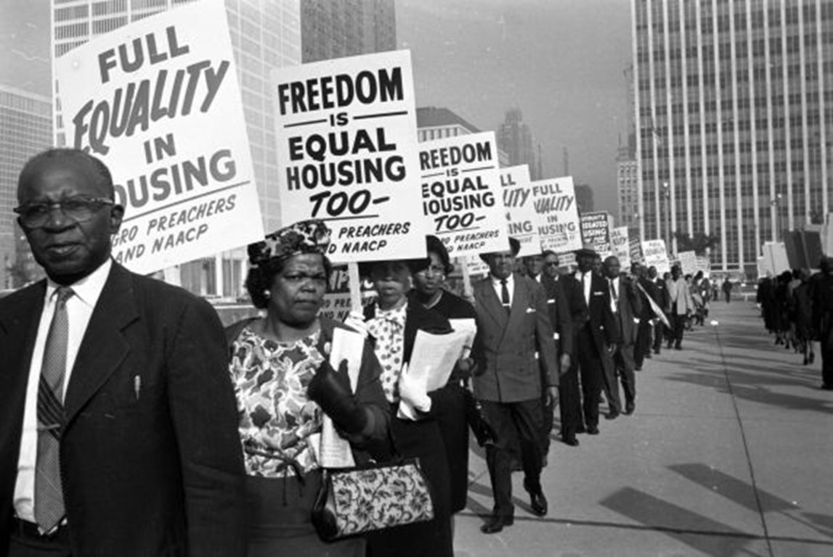

Slide 9
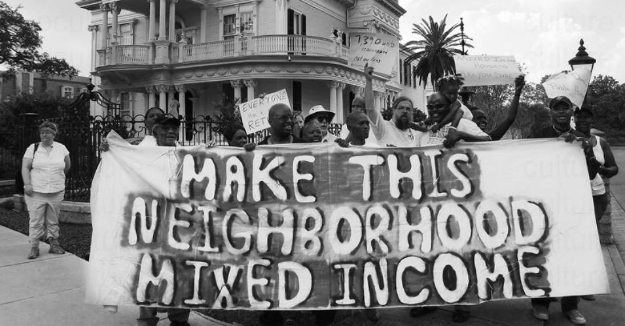

Slide 10
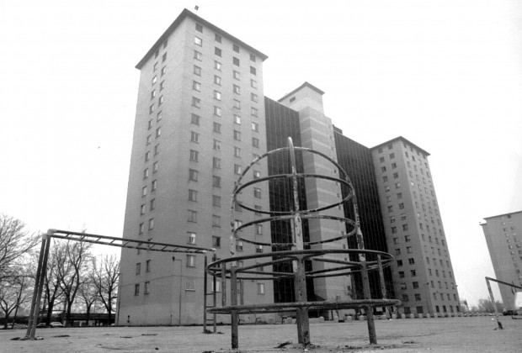

Slide 11
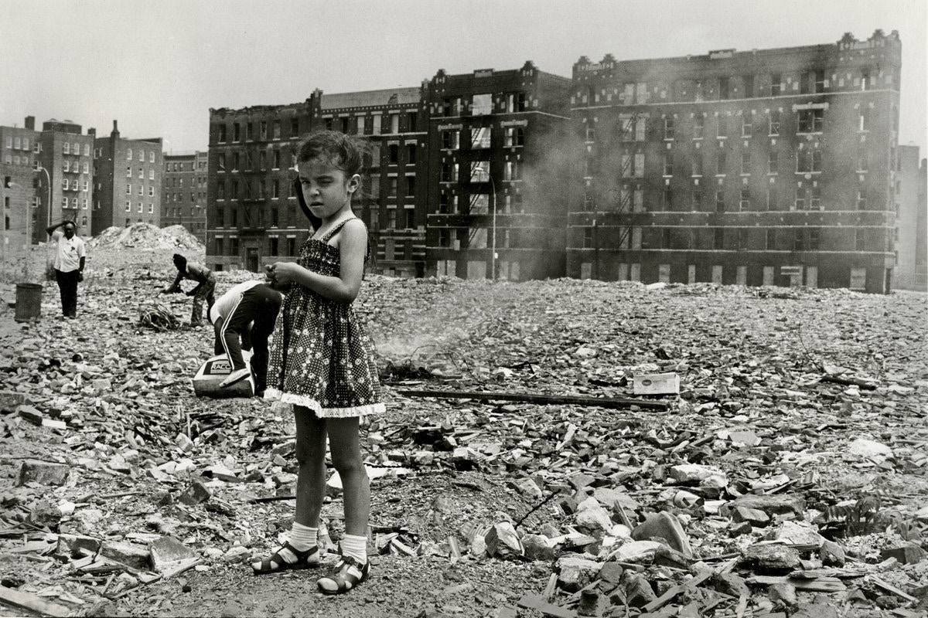

Slide 12
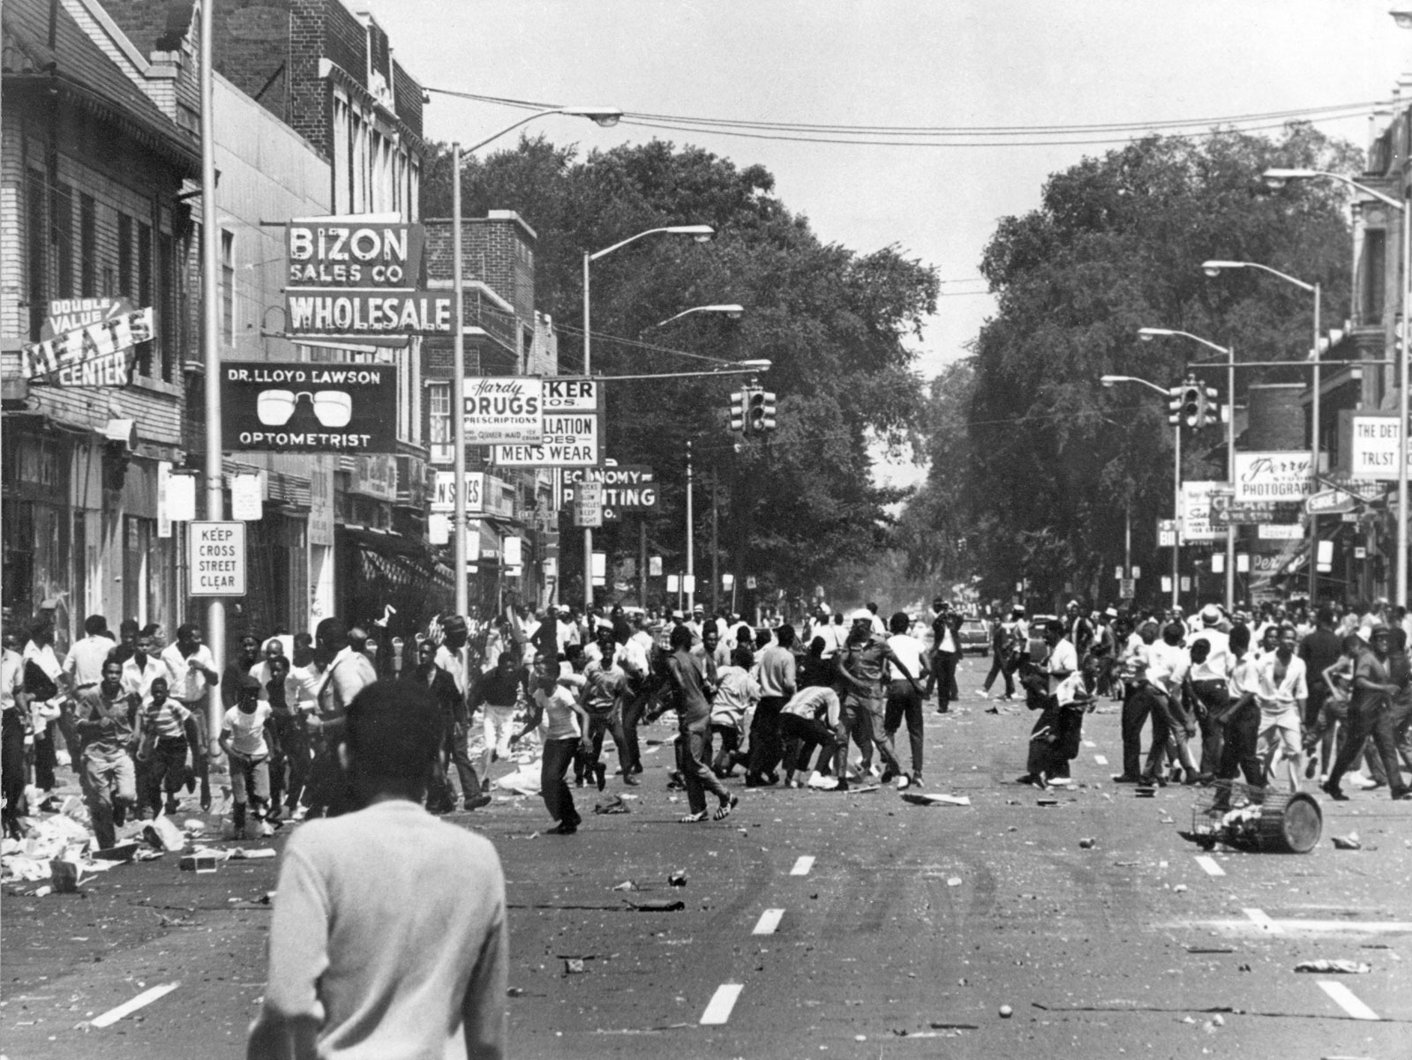

Slide 13
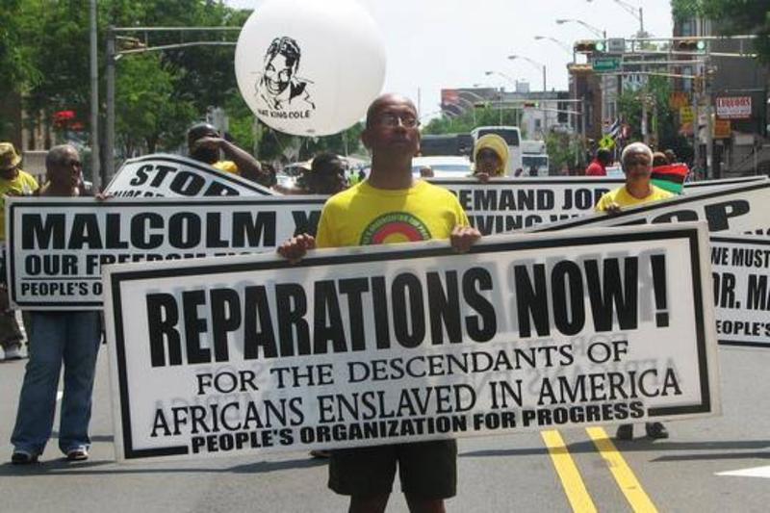

Slide 14
Photo 1: https://www.washingtonpost.com/news/wonk/wp/2018/03/28/redlining-was-banned-50-years-ago-its-still-hurting-minorities-today/
Photo 2 and 3: https://medium.com/@DmitriMehlhorn/a-requiem-for-blockbusting-68152244e77a
Photo 4: https://www.dcpolicycenter.org/publications/racially-restrictive-covenants-bloomingdale/
Photo 5: https://www.stltoday.com/shelley-v-kraemer-1948/article_a1a21ad2-e03c-11e7-9b20-6bb5c15289a2.html
Photo 6: https://www.stltoday.com/jones-v-alfred-h-mayer-co/article_e579a76e-e039-11e7-8197-e3c84814d7bc.html
Photo 7: https://harvardcrcl.org/on-the-50th-anniversary-of-the-fair-housing-act-where-are-we/
Photo 8: https://www.commondreams.org/news/2018/08/14/latest-attack-fair-housing-act-carson-moves-gut-anti-segregation-rule
Photo 9: https://www.chicagomag.com/city-life/May-2014/The-Case-for-Reparations-and-the-Legacy-of-Discrimination-Against-Probationary-Whites-in-Chicago/
Photo 10: https://www.jacobinmag.com/2019/08/decade-of-fire-film-south-bronx-nyc
Photo 11: https://www.britannica.com/event/Detroit-Riot-of-1967
Photo 12: https://www.wnycstudios.org/podcasts/tnyradiohour/segments/who-should-receive-reparations-slavery-and-discrimination

